Slide 1

Team Name : Mymtraminds
Team Details: Smita Singh(“Leader”/ “Developer”) Sneha Jaiswal(“Designer”) Sunidhi Tomer (“Devops”)

Slide 2

Project Overview And Goals
Project Overview
Demand forecasting is an estimate of sales during a specified future period based on the proposed marketing plan and a set of particular uncontrollable and competitive force
Goals:
Accurate demand forecasting serves as the cornerstone of business success, wielding its influence across a multitude of operational facets. The ability to predict future consumer preferences and market trends empowers organizations to make informed decisions, optimize resource allocation, and maintain a competitive edge

Slide 3
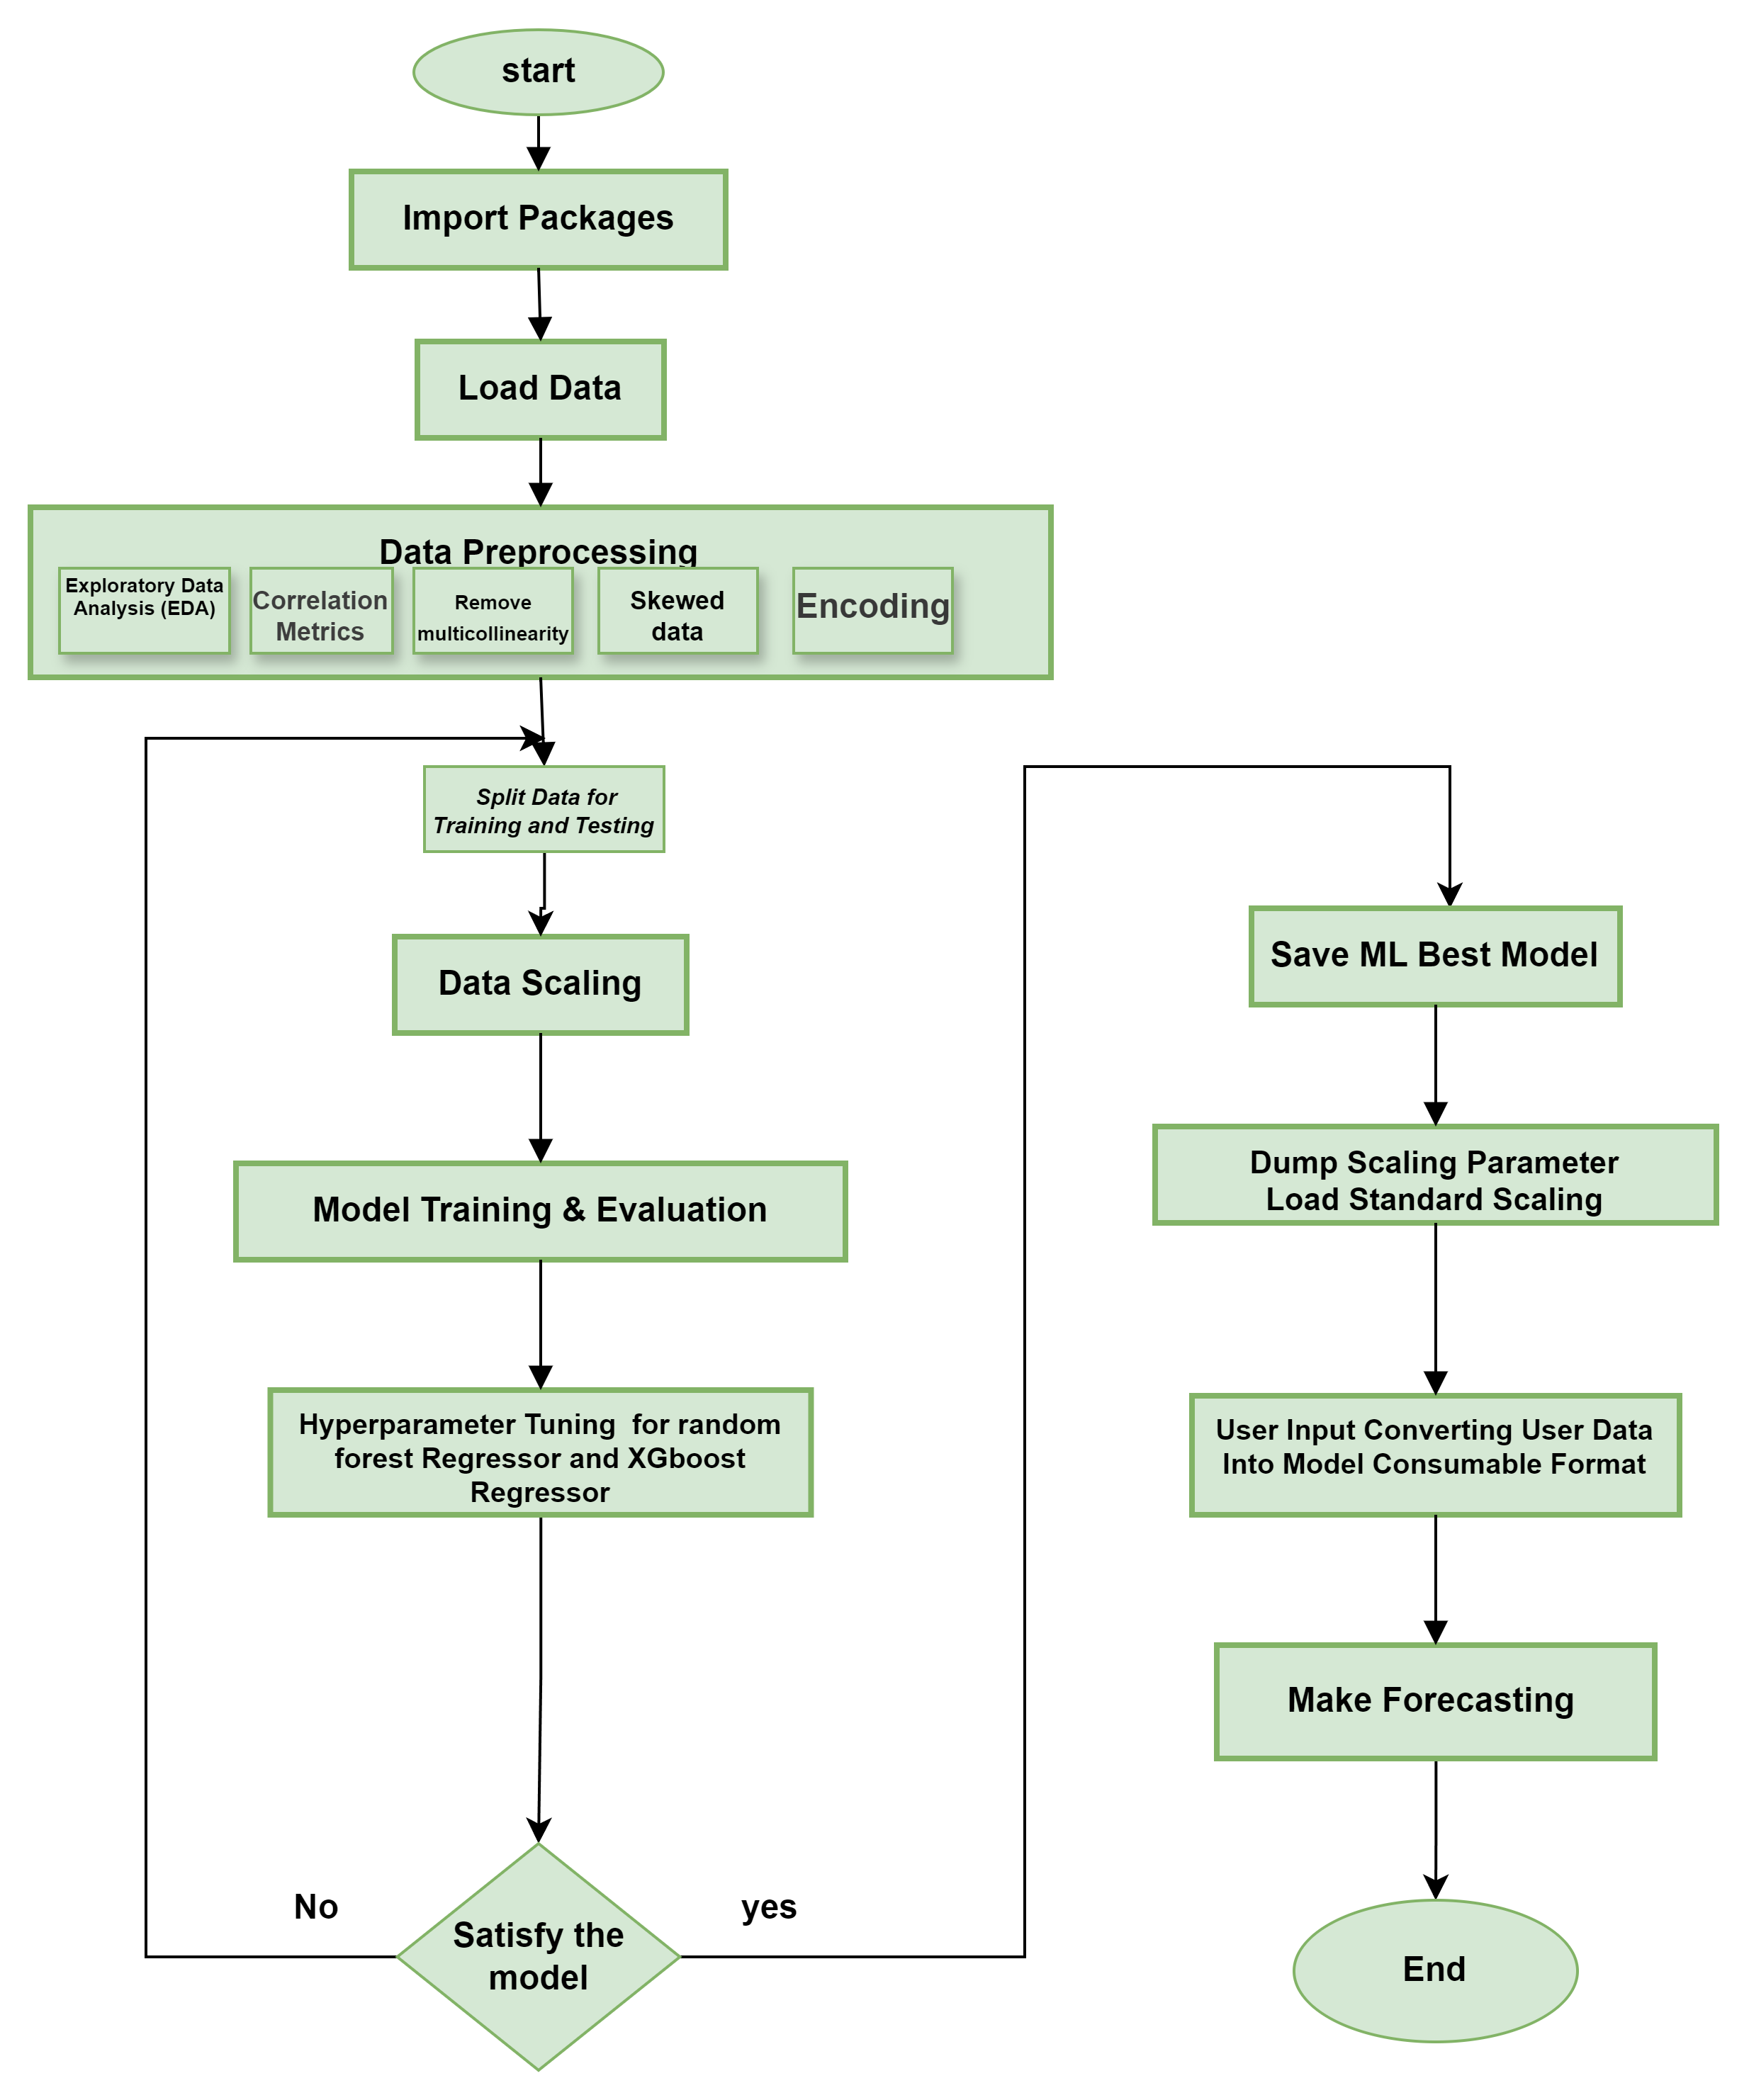
Strategic Approach and Workflow Diagram
Challenges
In the pursuit of precision and proactive decision-making, leaders in demand forecasting encounter a multitude of challenges that test their strategies and resilience. This section delves into the complexities organizations face as they navigate the intricate landscape of demand prediction.
Volatility and Uncertainty
Data Quality and Accessibility
Seasonality and Trends
Demand Fragmentation
Human Bias and Subjectivity
Why we need trend demand forecasting
Demand forecasting is particularly important for growing businesses, especially small and midsize ones. Businesses of stable size and sales don’t face the same risks and variation in outcomes that a company trying to grow quickly must prepare for, and mistakes in forecasting are more easily absorbed by a larger enterprise than a small one. Improper scaling is a major cause of failure among startups, and flawed demand forecasting can lead to just that by not preparing the company to fill a big order or by causing it to scale too rapidly to meet demand that doesn’t materialize.

Slide 4
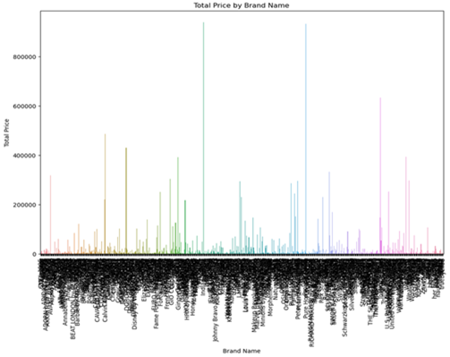
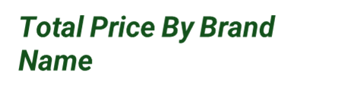
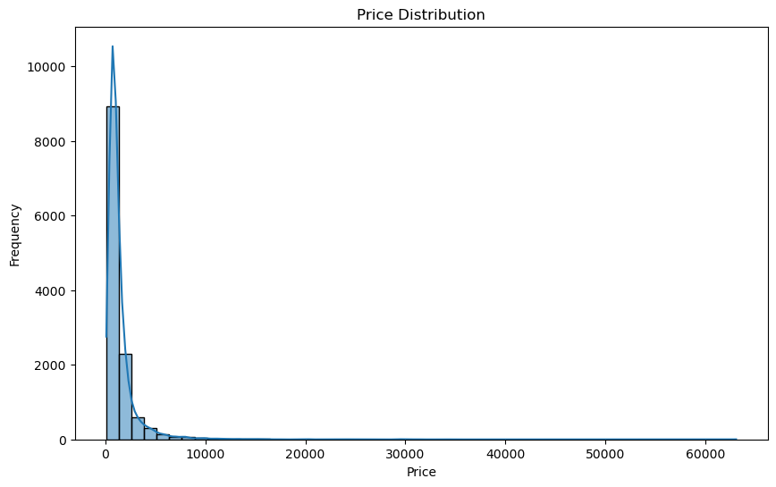
Data Collection & Preparation
We use this library (from sklearn.preprocessing import StandardScaler) for data preparation
Collecting relevant historical data on past sales, customer orders, Market Trends, Segmentation Data ,Product Categories , and other demand-related information.
Look for patterns, seasonality, and any significant events that may have influenced demand in the past. Historical data serves as the foundation for building our forecast.
We use dummy data of Myntra to train our model. During data preprocessing, we will generate a price distribution and total price by brand name diagram.
The function of the total price by brand name-
plt.xlable(‘Brand Name’), it represents the x-axis
plt.ylable(‘Total Price’), it represents the y-axis
plt.title(‘Total Price By Brand Name’).
And the price distribution
plt.xlabel('Price’), it represents the x-axis
plt.ylabel('Frequency’), it represents the y-axis
plt.title('Price Distribution')
Price Distribution

Slide 5
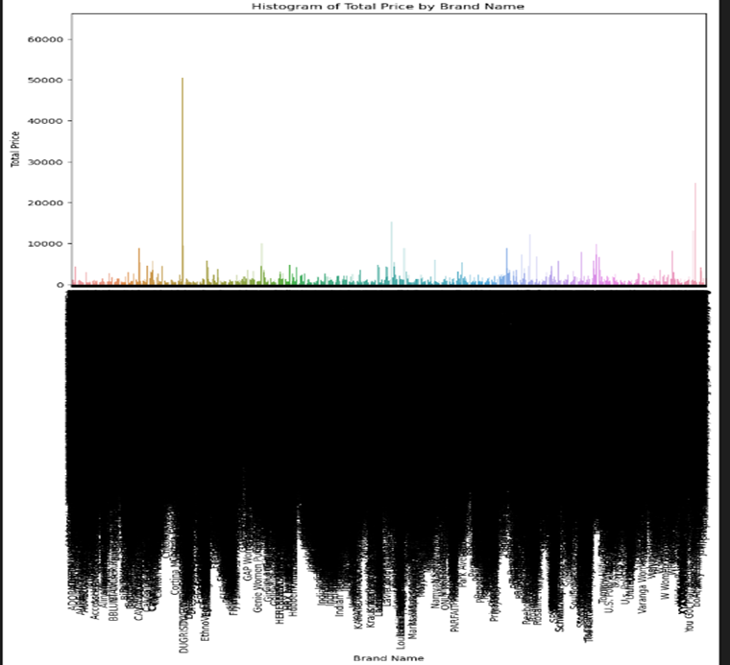
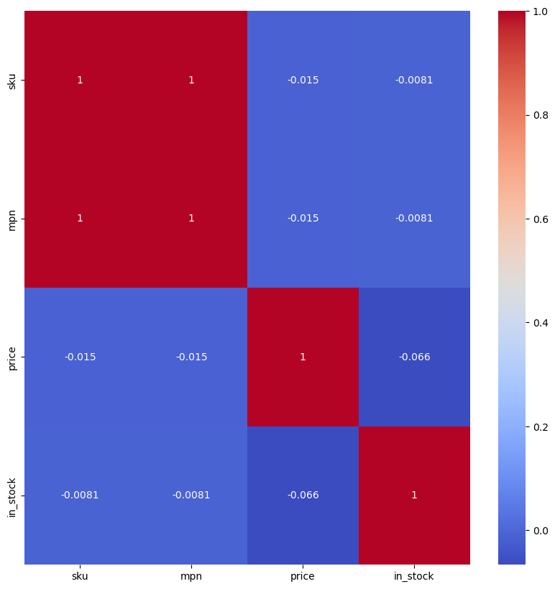
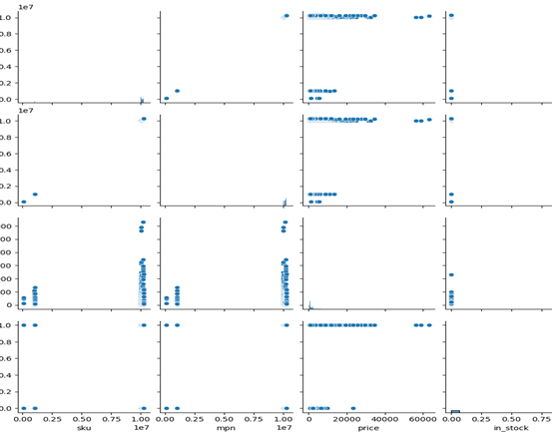
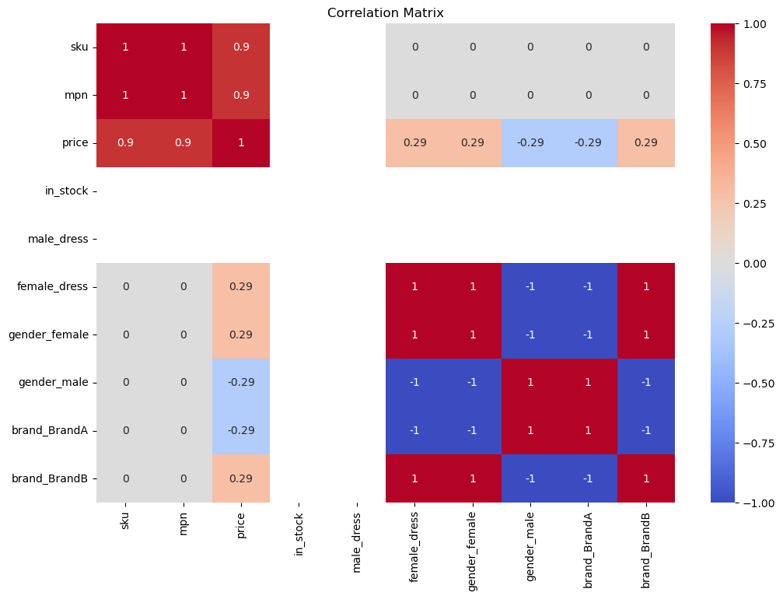
Exploratory Data Analysis (EDA)
we use the library (from sklearn.preprocessing import StandardScaler) for data preparation
Histogram is used to visualize the distribution of numerical data within a dataset it helps to identify the shape, central tendency, and spread of data. we use ( sns.barplot(x="name", y="price", data=name_price_sum) ) to generate the histogram.
Remove Collinearity used to detect and eliminate multicollinearity among predictor variables. It improves the reliability and interpretability of regression models by ensuring that predictors are not highly correlated with each other. ((sns.heatmap(data.corr(),annot=True,cmap="coolwarm") ) used to show the heatmap.
Pairplot used to visualize relationships between multiple pairs of variables in a dataset.it provides a comprehensive view of pairwise relationships, distributions, and potential outliers across several variables. (sns.pairplot(data) ) use to show pairplot.
Correlation Metrics is use to measure and visualize the strength and direction of relationships between numerical variables.it Identifies pairs of variables that have strong positive or negative correlations. (sns.heatmap(correlation_matrix, annot=True, cmap='coolwarm') ) use to generate corelation metrics
Histogram of Total Price By Brand Name
Remove Collinearity
Pair Plot
Correlation Matrix

Slide 6
USE CASE
Conclusions
Approach
Data Collection, Data Preprocessing, Exploratory Data Analysis (EDA), Model Selection (from sklearn.linear_model import Ridge, Lassofrom sklearn.preprocessing import PolynomialFeatures from sklearn.svm import SVR from sklearn.neighbors import KNeighborsRegressor from sklearn.tree import DecisionTreeRegressor from sklearn.ensemble import RandomForestRegressor from xgboost import XGBRegressor ) we select these librabries for model selection,Model Training
After selecting the model we trail and find xgboost and random forest are best , Trend Analysis , Seasonal Adjustment , Evaluation and Testing, Deployment - Implement the forecasting model in a production environment , Monitoring and Maintenance
Benefits
A retailer uses trend demand forecasting to predict high-demand products for the holiday season, ensuring adequate stock levels and maximizing sales while minimizing customer dissatisfaction.
The firms could employ an ML-based approach to forecast the demand for achieving a higher level of accuracy. We showed that the higher level of demand forecast accuracy translates into both improved operational and financial performance outcomes
Forecasting the impact of sudden change in demand can help businesses understand the potential implications of any external factors that may influence their operations. This knowledge can be used to develop strategies that allow businesses to remain competitive and respond quickly to sudden changes in demand.
Reference github. Link of our ongoing Project
https://github.com/Smita-04/Trend_Demand_forecasting

